Slide 1

Customer Feedback Management System

Slide 2

Introduction
Overview:
A system where customers can submit feedback about products or services.
Administrators can view and respond to this feedback.
Purpose:
Enhance customer satisfaction by addressing their feedback.
Provide administrators with insights into customer opinions.

Slide 3
Key Features
User Registration and Login:
Secure user authentication process.
Submit Feedback:
Customers can submit ratings and comments.
Option to rate various aspects of the service/product.
Admin Dashboard:
A central interface for administrators to view all feedback.
Respond to customer feedback directly from the dashboard.
Reporting Module:
Generate comprehensive feedback reports.
Identify trends and areas for improvement.

Slide 4

User Flow
Register/Login
Submit Feedback
View Past Feedback
Customer Side:
Admin Side:
Login
View Feedback
Respond to Feedbacks
Generate Reports

Slide 5
Technology used
Java Servlets:
For handling HTTP requests and responses.
JDBC (Java Database Connectivity):
To interact with the MySQL database.
MySQL:
The database system to store user details, feedback, and responses.
JSP (JavaServer Pages)
For creating dynamic web pages and simplifying code in JSP.

Slide 6
System Architecture
Client-Side:
Users interact with the system via a web browser.
Server-Side:
Java Servlets and JSP handle business logic and user requests.
JDBC connects the server with the MySQL database.
Database:
Stores user information, feedback entries, and administrative responses.

Slide 7
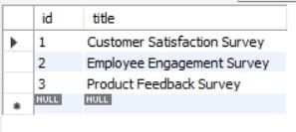
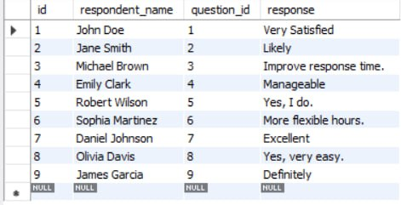
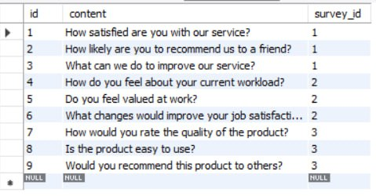
tables
Types of survey table
Type of survey related queries
Feedback from customers

Slide 8
Benefits of the System
Customer Satisfaction:
Direct feedback channel improves customer engagement.
Efficient Feedback Management:
Streamlined process for administrators to manage feedback.
Data-Driven Decisions:
Reports provide actionable insights into customer needs and areas for improvement.

Slide 9
Conclusion
The Customer Feedback Management System improves customer interaction and helps administrators respond to feedback effectively.’
Streamlines feedback processing by providing a centralized platform for managing and analyzing customer feedback.
Future Enhancements:
AI-based sentiment analysis for better feedback categorization.

